Slide 1
Power BI Gateway
Power BI Gateway

Slide 2
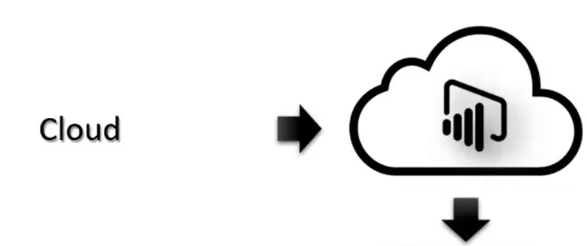
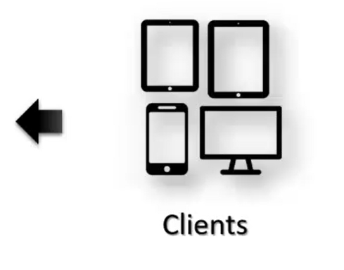
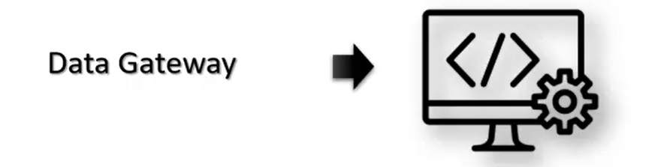

Why using Data Gateway

Slide 3
Personal Gateway
Individual Use: Designed for personal use or a single developer working independently.
Limited Access: Used for refreshing datasets of reports or dashboards published in the Power BI service.
No Sharing: Does not support sharing connections or refreshed datasets with other users.
Functionality: Works only when the user is logged into the machine where the gateway is installed.
Standard /Enterprise Gateway
Organizational Use: Intended for organizations, allowing multiple users to access on-premises data.
Sharing and Collaboration: Enables shared connections to data sources across users
and Power BI services.
Multi-Use: Supports Power BI, Power Automate, Power Apps, and Azure Logic Apps.
High Availability: Can be configured in clusters to ensure high availability and avoid disruptions.
Enhanced Security: Offers stronger security mechanisms for sensitive data.

Slide 4
Personal Gateway vs Enterprise Gateway
There are several reasons why you might choose the personal gateway over the enterprise gateway:
Simplicity: The personal gateway is simpler to set up and manage, as it is installed on a single computer and does not require any additional infrastructure.
Cost: The personal gateway is free to use, while the enterprise gateway requires licensing.
Use Case: The personal gateway is designed for scenarios where you have a single on-premises data source that needs to be accessed by a few users or reports.
The enterprise gateway is designed for larger organizations with multiple data sources and a larger number of users.

Slide 5
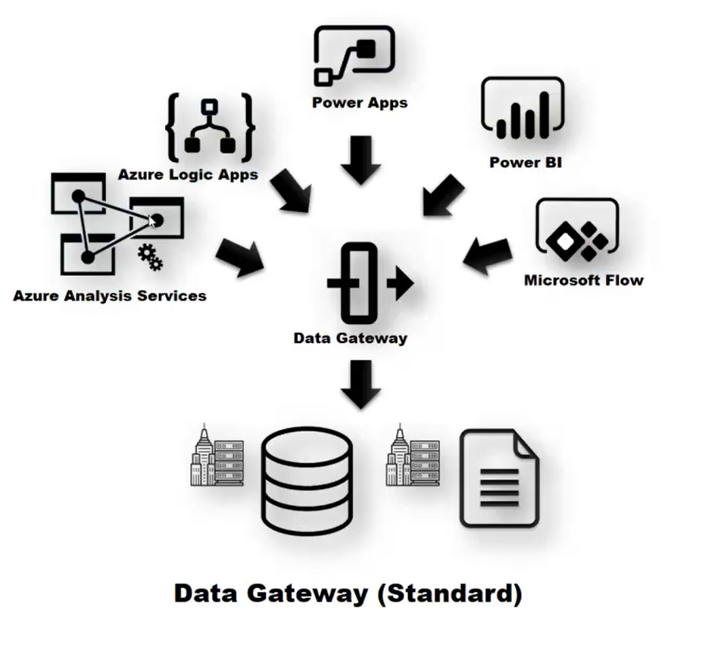
Personal Gateway vs Enterprise Gateway

Slide 6
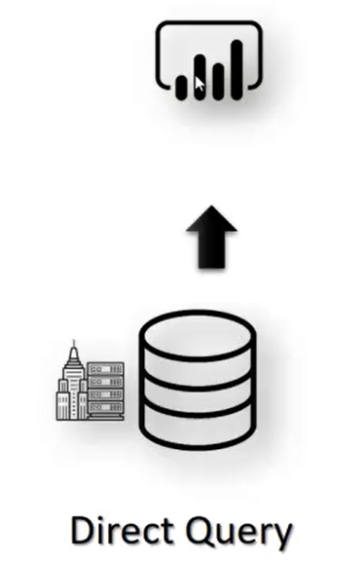
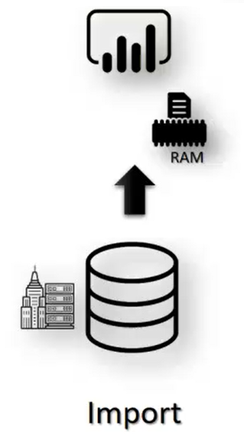
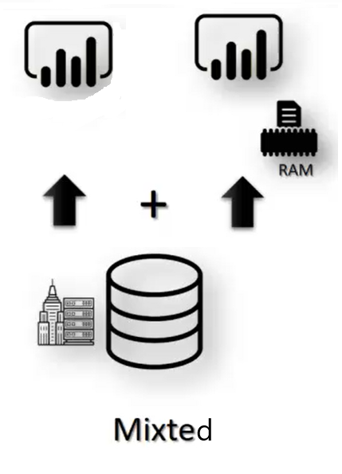
Different modes of Data Gateway

Slide 7
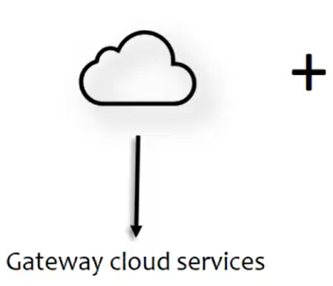
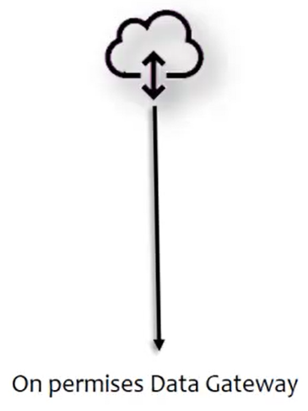
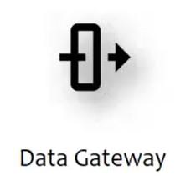

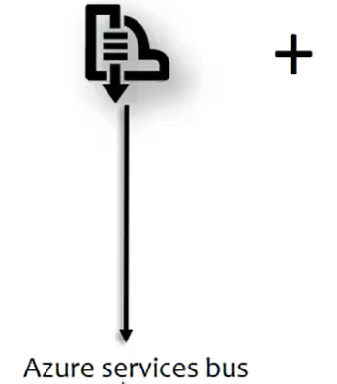
How Data Gateway Works

Slide 8




Data Gateway integration
Install
Add users
Connect users
Refresh

Slide 9
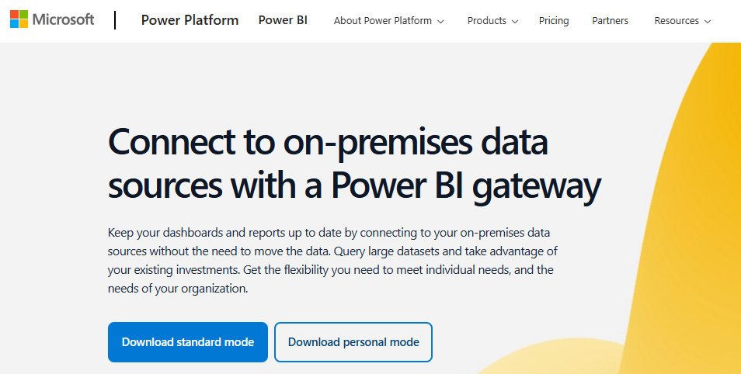
Step 1
1
2

Slide 10
Step 1
1
2

Slide 11
Demo: Gateway integration

Slide 12
Thank you
Thank you

